Slide 1
hybrid Computer
Interface
bY : aDITYA aTHALYE 7
aKSHAY bAVISKAR 8
vIRAJ dESHMUKH 17
pARAG rAJHANS 47
vIKAS sINGH 51

Slide 2
Introduction
Virtually all home computers today use traditional interfacing i.e., with keyboard and mouse.
New home pc’s are also being developed and introduced which include touch screens and voice support which increases the level of interactivity but increases the cost significantly.
Wouldn’t it be cool if you could just point at screen, wave your hands, make gestures, give voice commands and watch your actions controlling your pc or workstation and that too which is cost effective? Definitely it would be super cool.
Our Project Aims Exactly at this…It Aims at Creating a Hybrid Computer Interface at Low Cost

Slide 3
Hybrid ????
Hybrid Means “Mix”
So in our context Hybrid Controllers for pc means using a mixture of controllers (apart from the traditional Mouse and Keyboard) to Interact with the computer
It is not only limited to computers but to any interface which is configurable

Slide 4
What Controller ?
To form the hybrid interface…a number for devices, softwares are used which are made from ground up or readymade
In our Project we will be using the controller of a popular gaming console Nintendo Wii—the contoller– WiiRemote (wiimote) and Nunchuk
All communication between wiimote and pc will be done via Bluetooth
Programmer Software : GlovePIE

Slide 5
Why Wiimote ??
Our Project Deals with controlling the computer by implementing the concepts of Hand Motion movements, Universal Touch screens, Finger Tracking, Gesture Tracking
All the Above Concepts are Inbuilt into the Wiimote and the Nunchuk
That means…my Wiimote And Nunchuk can sense my movements, Motion Gestures and many more..

Slide 6
So Using Capabilities of Wiimote And Nunchuk (IR Tracking, Motion Capture, Gesture recognition and Buttons!!) we can control the pc
Example: If My Wiimote and Nunchuk are swung upwards.. can write a program to detect upwards motion and perform a window close operation on my pc

Slide 7
Similarly we can write a program to track an infrared source of light (by wiimote’s inbuilt infrared camera tracking by spatial triangulation) to control a mouse on screen.
Thus my combining such programs we can create a virtual interface in which we just move our hands, make motion gestures, touch the screen or speak to interface with the computer.
The Programmer used to do all this is GlovePIE .

Slide 8
Into the Virtual Interface
We will now be starting with our project description, what is included, what hardware, what software, sample codes etc
Here we will be exactly describing how we exploit the hardware to create an all new interactive interface to our computer

Slide 9
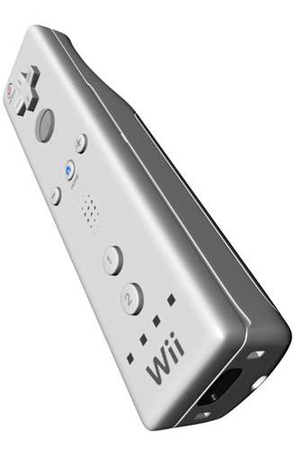
Starting With Hardware:
Wiimote
A main feature of the Wii Remote is its motion sensing capability, which allows the user to interact with and manipulate items on screen via gesture recognition and pointing through the use of accelerometer and optical sensor(IR Tracking).
It also includes 12 digital buttons

Slide 10
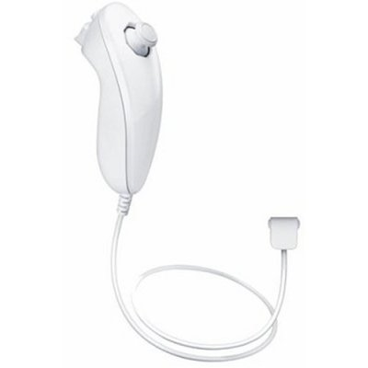
Nunchuk
Like the Wii Remote, the Nunchuk also provides a three-axis accelerometer for motion-sensing and tilting, but without a speaker, a rumble function, or a pointer function.
The Nunchuk’s accelerometer is an STMicroelectronics LIS3L02AL.

Slide 11
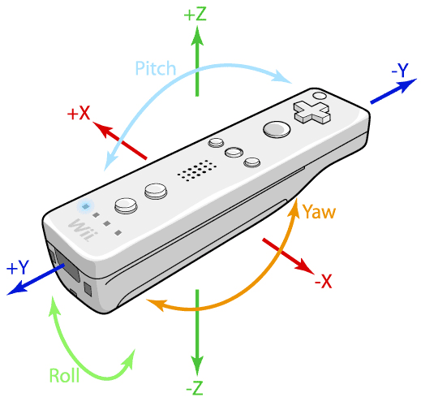
Motion Awesomeness
Referring to the image..we can track the wiimote’s inclinations in three axis x, y, z
Each Axis is tracked from a point range of -10 to +10 with a precision of two floats i.e., from -10.00 to +10.00

Slide 12
Through the GlovePIE Programmer, we can also track the wiimote’s and nunchuk’s relative motion i.e., not just the inclination but also the swing actions (relative motion).
Thus, if we map the direction keys and other keys on the wiimote to arrow keys, enter key of keyboard and also map the swing right ,swing left and swing up motions, we can navigate in a window by swinging wiimote or nunchuk left, right to go to next or previous directory, swing up to close a file, press a button(mapped to enter key) to open a file

Slide 13
Also, by tracking the inclination in real time, we can create controls for many games such as flight simulator where, if ,holding the wiimote vertically, we tilt the wiimote forward, (i.e. by increasing the y-axis inclination of wiimote), we can make the plane dive or in contrast make it leap
It is like we are actually controlling the flight by tilting the wiimote as if it is the plane’s joystick
Various other orientation differences can be mapped to simulate driving a car, or a bike

Slide 14
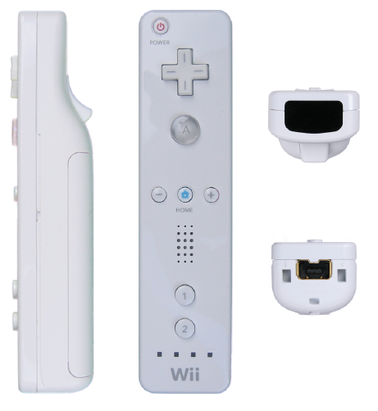
IR Tracking :
IR Tracking is the Tracking of movement of an IR light Source Used To Communicate with the PC.
This Is Done By The Wiimote IR Camera.
By Using IR Tracking and By Implementing Various Codes, We Can Control Computer By Our FINGERS(Finger Tracking) And Also Turn Any Display into TOUCHSCREENS!!!!!!!!!

Slide 15
Finger Tracking
What Basically We will Be doing is track our fingers and move them around in open space to control the mouse on screen and perform other functions.
How this is Actually done is: the user would wear 2sets of gloves which would have IR-LEDs attached to the Tip of the of the thumb and First Finger on both the gloves

Slide 16
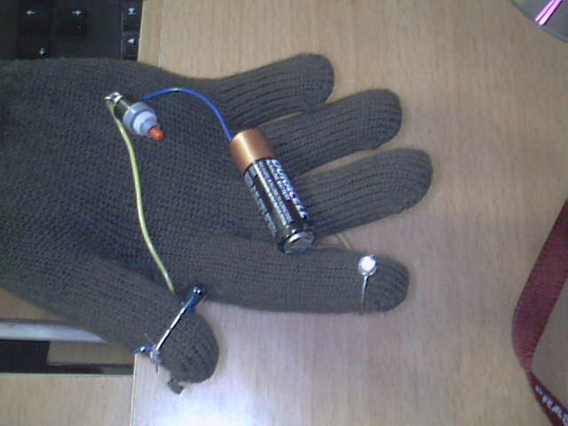
The image shown is a prototype of our glove.
As you can see it has IR-LEDs attached to the thumb and first Finger and are switched on via a power supply.
For Finger Tracking, the IR-LEDs will Always be switched on.

Slide 17
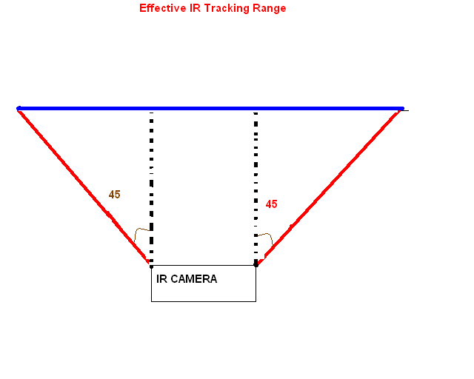
The Wiimote’s IR Camera Tracks IR Light By 45degree range as given in the picture where the Blue Line Indicates Effective IR Tracking Range Of the Camera.
The wiimote will be placed above the computer screen in front of the user from where the camera can see the IR LED on the user’s glove

Slide 18
Once Placed, the camera Can Track the position of the IR LED in a total resolution of 1024x768 irrespective of the LED’s distance from the camera.
Thus the Exact Co-ordinates of the IR LED is Determined by Spatial Triangulation and after the co-ordinates in real Coordinate System is determined, it is translated into cursor co-ordinates by the Resolution set on the monitor.

Slide 19
So, As the Finger is moved in air, the cursor on screen in moved.
The Wiimote can track up to 4 IR Sources so we can write programs to perform various functions by tracking 4 IR LED fitted gloves i.e. 2 on each glove.
Example, 1 Led Will control the movement of cursor, and if the second led is detected, the program will perform double Click and so on..

Slide 20
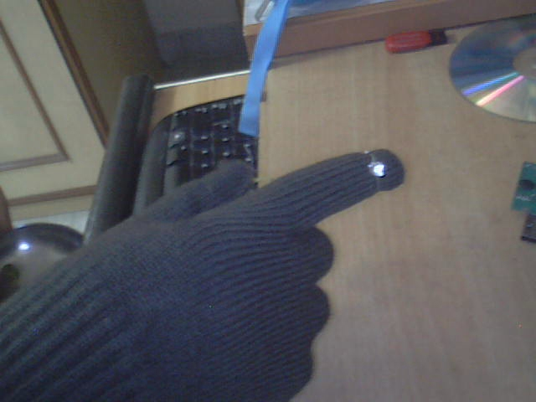
Universal Touch Screen :
This Is Also Implemented By IR Tracking.
It is Similar to Finger Tracking in concept and design but different in working.
The IR LED is Placed on the Nail-side of the give and is not constantly on.

Slide 21
This Depends on Tracking of the IR LED respective of the Distance from the camera i.e., the tracking values will change if the distance between camera and IRLED is changed.
Thus the Wiimote is Placed Behind the user from where it can see the monitor in a 45degree view.
The Tip of the first finger of the glove has a pressure switch which switches on the IR LED only if the user touches the screen with his finger.

Slide 22
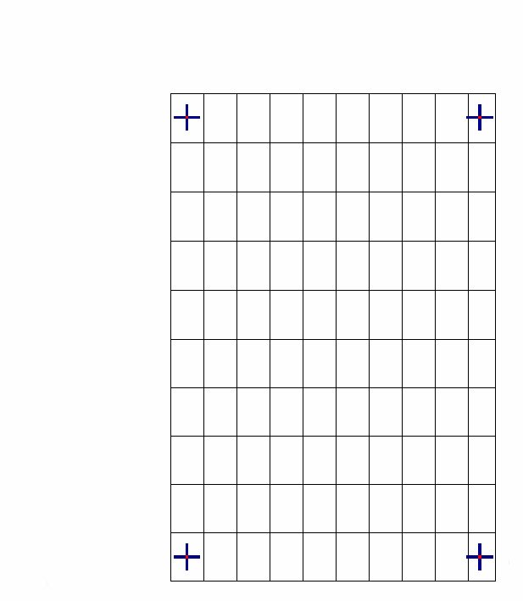
So, First the 4point Touch Calibration is done.
What it is actually is, it maps the distance of the monitor from the camera and converts the monitor co-ordinates to camera co-ordinates .
The user is provided with 4 points on screen where he must touch, this provides the co-ordinates of where the user has touched and then translates it into monitor resolution co-ordinates.

Slide 23
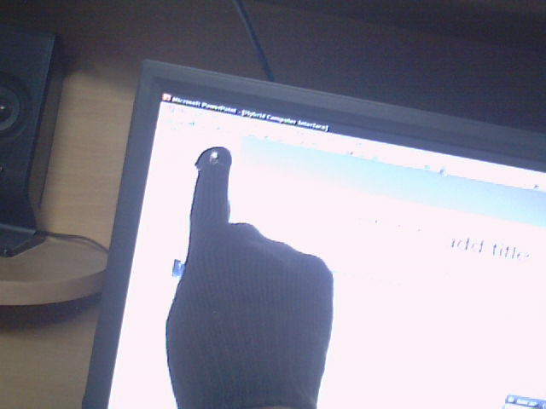
Once This Is done, the user then just have to touch the monitor on various icons buttons etc.
When the user touches the screen, pressure switch enables the IR LED and this is registered by the wiimote and is interpreted by our program as a single click.

Slide 24
So now, the user just have to touch, drag ,tap, double tap and control the computer via touch as if it was a real touch screen.
That means simply double tap on an icon, and the application will open.
Simply touch and drag the scrollbar up and down and scrolling will be done.
Simply Touch and Drag in paint, and start drawing by directly scribbling on the screen

Slide 25
GlovePIE and Voice
GlovePIE is the base for our programming needs.
This Programmer can connect to various gaming controllers via Bluetooth, USB or controller specific dongles.
We mainly use it to send and receive commands and data from wiimote and nunchuk and microphone.
The nunchuk must be connected to the wiimote if we want to use it

Slide 26
How to Program ?
The GlovePIE programmer uses standard programming language which is cross sewn in from java, C, C++ etc
It means that a standard set of protocols(from C,C++,Java) for language is used to write programs in GlovePIE.
Example: a single if statement can have multiple syntax in GlovePIE
If (condition) {
//statement }
Else {
//statements }
Or the syntax can also be as follows
If //condition// then
//statement
endif

Slide 27
Every Attribute of every controller is accessed by Object Oriented Method where each attribute (ex:buttons) is a variable of object of controller class.
Incase of our wiimote, the wiimote becomes the class wiimote1(number of wiimote) becomes its object and the buttons(A, B, Left etc) become the variables.
So If I want to access A button of wiimote, it would be accessed as wiimote1.A

Slide 28
Language versatility and sample code
The picture shows the GlovePIE Programmer and a sample code of emulating keyboard keys via wiimote in different ways.
The GlovePIE uses a Linear but iterative execution method which means once the code has been executed from top to bottom, it will again start from top

Slide 29
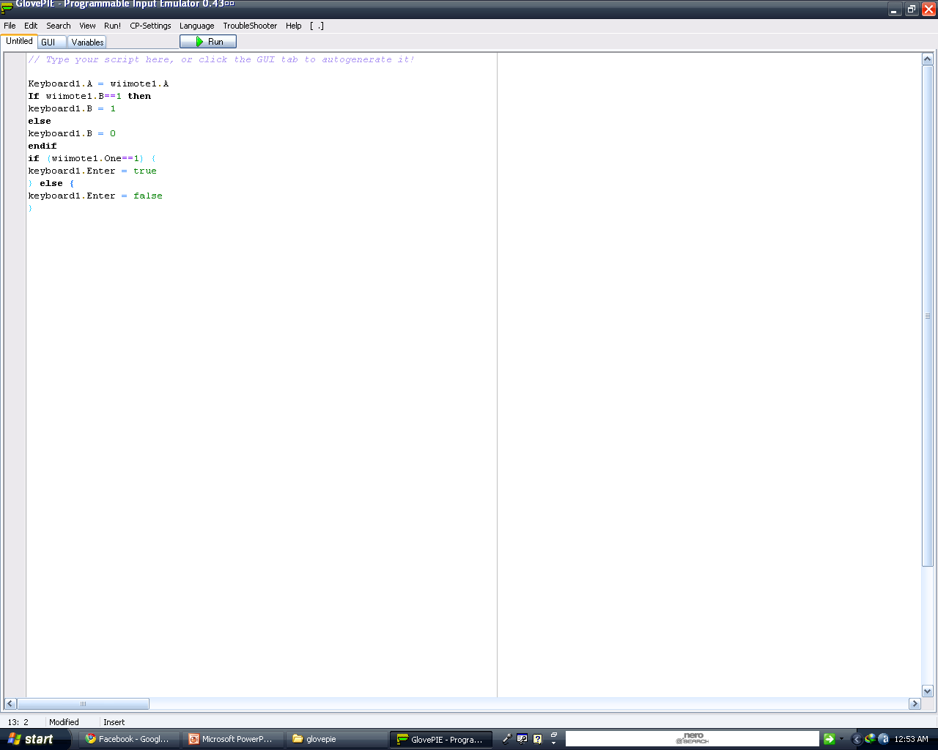

Slide 30
Voice Magic
As said previously, GlovePIE can interpret various controllers which includes microphone.
It can interpret what is being said into the microphone using Windows’ built in Voice Interpretation tool.
Thus we can also write codes which accept voice commands and then assign different functions.
Ex:if “minimize all” is said into the microphone, Windows key+M of keyboard would be emulated which would minimize all open windows

Slide 31
Just Wait And Experience
So, with this we bring an end to our presentation upon our project
We invite you and urge you, at the same time, to wait for our project to leap ahead of its final beta stages and out of its development stages and then experience our Hybrid Interface to your PC...

Slide 32
Thank you…..

